Slide 1
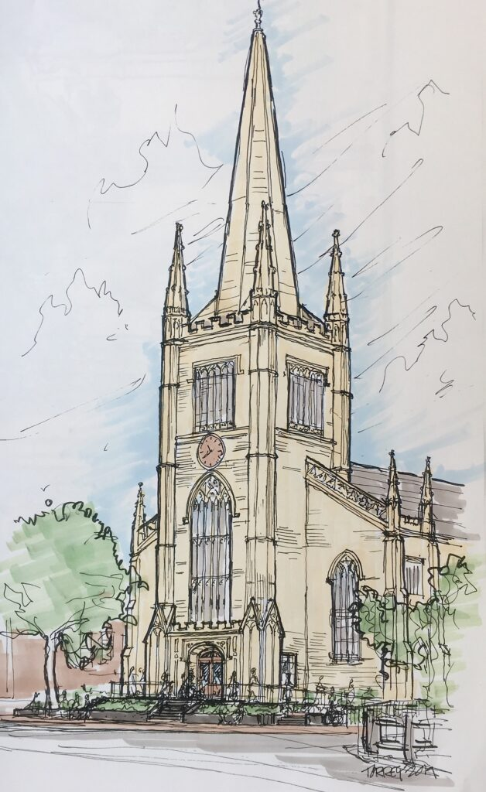
First Parish Building Repair Proposal

Slide 2
Key Activities from the March Building Update
Update our 2018 site assessment and use to prioritize critical near-term repairs and improvements that can be accomplished with our currently available resources. This includes an evaluation of the evolving space use needs at First Parish.
Work on a building use plan that includes the interior and exterior and provides an overall vision for our physical space. This will be done in concert with the congregation, staff, and potential outside stakeholders.
Explore options for a long-term community partner for First Parish that would be willing and able to help fund this overall vision for the building.

Slide 3
Top Priorities Identified from Activity 1
Return the Meetinghouse interior to a useable condition - $155K (Summer)
Repair water damage to meetinghouse and minister’s office - $62K ($127K estimate minus $65K insurance reimbursement)
Replace balcony plaster ceiling - $93K (part of Phase 1 work)
Return exterior of the Meetinghouse to a visually acceptable condition - $460K (Fall)
Repair and paint East (front) wall - $230K
Repair and paint South (Church St.) wall - $230K
Address highest-risk deferred maintenance item - $320K (Timing TBD)
Parish House North wall instability; free-standing masonry wall is bowing outwards and needs to be stabilized - $320K
Total cost is $935K

Slide 4
Sources of Funding
First Parish Endowment- $600K
In December, $600K was disbursed from the endowment in preparation for Phase 1 work which has remained unused
Building Fund Donations - $250K
Over $250K has been committed to the building fund in anticipation of Phase 1 work
Cambridge Historical Commission- $200K
Based on conversations with the CHC, we think $200K in grants would be available for this work
Total available is up to $1,050K

Slide 5
Additional smaller-scale projects
There is also a prioritized list of smaller projects to be done as funds become available each year. This list will be continuously evaluated and updated based on evolving needs:
Address Water Leakage & Infiltration issues on the East and Southeast Corner Elevations
Meeting House miscellaneous slate repairs at North and South roofs
Parish House Miscellaneous roof flashing, gutters, vents, valleys, parapet and slate repairs
Parish House miscellaneous brick repointing and resetting
Construction of wooden ladder/stair and safety rail in order to provide better/safer access to the Meeting House attic
Provide heating & cooling to the Elevator machine room
Remove and replace remaining knob and tube wiring from the Parish House
Design a ventilation system for the Meeting House Mezzanine Level classrooms

Slide 6
Congregational Approval
In order to move forward with this plan, the congregation will need to vote to allow the $600K already disbursed from the endowment for the Steeple, Tower, and Entrance Project to be used instead for the proposed series of projects. This vote will occur at the June 5 Annual Meeting. Because there is only about 10% in excess contingency funds available, there is a chance that the congregation may need to approve additional endowment funds at a later date.

Slide 7
Questions?

